Slide 1
IABC Treasurer Orientation
8 December 2022

Slide 2
Agenda
Update on New Financial Model
Background
Opportunities
Timeline
Questions
How the New Financial Model
Annual Financials
Budget & Forecasting
Financials Polies and Procedures
Monthly Financials
Daily Financial Management
Revenues
Expenses
1099 Requirements

Slide 3
IABC US Chapter Region Update
Over the 2020 – 2022 fiscal years, IABC has experienced a period of accelerated change due to the pandemic and economic conditions. A number of US chapters in particular struggled to fully function during the pandemic -- and some chapters’ struggles pre-dated the pandemic. The International Executive Board has decided to confront waning membership and engagement in those chapters who are not meeting the criteria necessary to be considered “in good standing.”
There are three discrete categories for US chapters based on the criteria within the vitality report:
Dormant
Struggling
Good Standing

Slide 4
IABC Chapter Update: New Model Available
Chapters in the Struggling or Good Standing Categories will be able to take advantage of centrally manage financials through the International organization.
With financial and administrative functions centrally managed through International there are the following benefits and opportunities:
Overall reduction of administrative workloads to increase focus on programmatic activities at the region and chapter levels.
Free Access to international’s accounts payable system (Concur) to submit payment requests and reimbursements.
Increase purchasing power through economies of scale in providing enterprise access to Zoom, web hosting, and digital/email marketing platform
Streamlined financial reporting and forecasting and will be part of the quarterly forecasting process.
Centrally Managed chapters and regions will receive a monthly statement of activities.
Chapters and regions will be part of the annual audit process.
Removes obligations for 990 gap filings.

Slide 5
IABC US Chapter Region Update
US CHAPTERS: There is also a need to address the US chapter filing that need to be submit gap filings for 2015 – 2021.The additional fee will likely be $6000 to complete the filings and reinstate the chapter as a tax-exempt entity.
NOTE: Chapters do have the option to move to a centralized model if they prefer to forgo prior filings.
Gap filings must be completed by no later than May 2022

Slide 6
Timeline for Shifting

Slide 7
First Completely Centralized Region
Beta test is planned for one of the US regions to be centrally managed by HQ starting in Q2 of 2023.
Learnings from the beta test group will be shared

Slide 8
Central Financial Management Q&A
Questions?
Comments?
Concerns?
Ideas?

Slide 9
How it Will Work: Budgeting and Forecasting

Slide 10
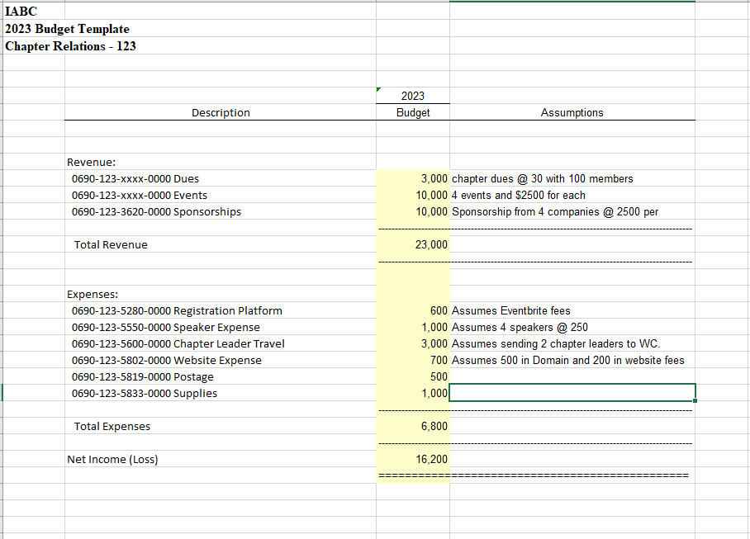
Operating Budget
A budget is a prediction of future financial performance – expenses, revenues and cash flows.
Used to make current and short-term decisions.
A budget needs to be approved (voted on) by the entire Chapter Board of Directors and the standard is that it shouldn’t change during the fiscal year -- changes are instead reflected in a forecast.
IABC HQ can provide a template for chapter to use that matches IABC HQ

Slide 11
Forecast
IABC HQ will provide a 6+6 template for chapter to use that matches IABC HQ
A forecast is a prediction of future financial performance – revenues, expenses and cash flows.
This is the mechanism to track subsequent operational changes to the budget.
Used to make current and short-term decisions.
Best practice is quarterly forecasting, or as needed.

Slide 12
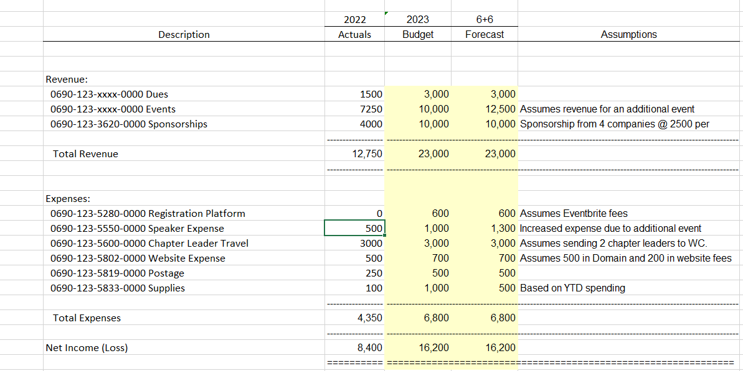
Forecast Example

Slide 13
IABC Region Budget Timeline
Late Summer:
Set strategy and priorities
October/November:
Template is created by HQ and sent to Region Treasurer for input
Region Treasurer works with Regional Board to complete budget template
Reviewed and Approved by Regional Board at Fall Board Meeting
December:
Review and approval by IABC HQ Finance Committee, IABC HQ Executive Committee and International Executive Board

Slide 14
IABC Region Forecast Timeline
IABC Regions and Chapters typically forecast once a year (Or as needed):
6+6 (6 months of actual (June), 6 months of forecast)
Templates provided by Director of Finance
Populated by Region Treasurer and send of Regional Board review and approval
Once approved by Regional Board, uploaded for next month’s financials

Slide 15
Monthly and Daily Financial Management

Slide 16
Operational Standards – Financials
Reviews financial package monthly
Any adjustments can be sent to the Director of Finance to be completed the following month
Annual budget to be reviewed and approved
No deficit budget; breakeven or profit
Unbudgeted expense of $2,000 requires Region Chair or Treasurer approval
At Local level, unbudgeted expenses of $500 requires Local Steer Committee approval
Integrate Regional strategies
All contracts should be reviewed and signed by IABC HQ
This benefits chapters and regions as IABC HQ has significantly greater purchasing power through Smithbucklin and can assist in getting the best possible prices and coverage in contracts.

Slide 17
Monthly Financials

Slide 18
Financial Statement Issuance
For Chapters and Regions that are going to a Centrally Managed Financial Structure:
Standard Financial Statement package consists of:
Statement of Activities and General Ledger
Financial statements are prepared by a Senior Accountant and reviewed by the IABC Director of Finance and operations team before issuance to IABC volunteers
Financial statements are issued to each Treasurer and Chair by the 17th business day of the following month
Treasurer’s send each Local Treasurer their financial statement as needed
IABC currently operates on a calendar year for its fiscal year; January 1st – December 31st *
*IABC’s Fiscal Year will change from 1 July – 30 June in 2024

Slide 19
Statement of Activities (Income Statement)
Describes the organization’s performance over a specified period of time (month, quarter, year, etc.)
Revenues – Expenses = Net Income / (Loss)
Can be basic with summarized categories or with a great degree of detail (program’s revenues and expenses)
When reviewing SOA, should be able to answer:
What was the total net income (loss) last year?
What is the annual budget and/or forecast for current year?
What percentage of the budget is represented by the year-to-date amounts?

Slide 20
Daily Financials

Slide 21
Cash Receipts - Lockboxes
Regions Lockbox will be set up at CIBC Bank.
Checks send directly to the bank allows for most efficient check deposit because money is received directly by bank.
Copies of deposited checks received daily from bank through online system.
Canadian Regions (if applicable) go to CIBC Bank and deposit checks directly at the bank as there is no Lockbox option.

Slide 22
Cash Receipts – Credit Cards
Credit card payments are processed online through IABC’s Association Management System (AMS): Impexium.
Automatically settles into CIBC checking accounting the next business day.
Credit Card refunds are processed with proof of original payment.

Slide 23
Cash Disbursements – US
Invoice/expense reimbursements are entered into the Finance Portal (Concur).
The invoice and any related back-up should be uploaded
Expense GL coding is required
Region Treasurer approval is required in portal
Invoices/expense reimbursements entered by end of day Monday will be paid by Friday the following week.
Processed internally on Tuesdays
Checks are signed and mailed on Friday/Monday
IABC staff reviews invoice for proper expense GL coding, approvals and 1099 status if applicable.
Payment can be made via bank transfer.
Voided check or routing number and account number is required.

Slide 24
Cash Disbursements – International
Invoice/expense reimbursements are emailed to IABC’s Membership & Operations Manager.
The invoice and any related back-up should be included
Expense GL coding and Region Treasurer approval is required
Invoices/expense reimbursements sent by noon CST Monday will be paid by Friday that week.
IABC staff reviews invoice for proper expense GL coding, approvals and 1099 status if applicable.
Payment can be made via bank EFT direct deposit.
Name, Financial Institution ID, Transit Number and Account Number are required.

Slide 25
Prepaid Debit Cards
Region Chairs and Treasurers will be offered the use of a prepaid debit card.
Regional Treasurer responsible for submitting receipts to Membership & Operations Manager within 3-5 business days after card use.
Invoice, receipt and expense GL coding is required
Regional Chair and Treasurer are responsible for safekeeping of the card. If card is stolen or lost, contact the credit card company immediately.
Prepaid Debit Card Best Practices will be distributed.

Slide 26
1099 Reporting

Slide 27
1099 Reporting
IABC HQ will file Form 1099-MISC, Miscellaneous Income, for each person to whom you have paid during the year at least $600 in rents, services, prizes and awards or other income payments.
Prizes include anything given away from gift cards, vacations/airline tickets, cash prizes, etc.
IRS rules state that if these gifts/prizes are valued at $600 or more, than a 1099 must be issued to the recipient as they must report this income on their tax return.
The $600 threshold is a cumulative amount on an annual basis (Jan 1 – Dec 31).
In order to issue the 1099 with accurate information, a W9 will be needed from the recipient.

Slide 28
2022-23 Finance Committee
Treasurer: Ann Marie Blake
IEB Chair: Alain Legault
IEB Vice-Chair: Maliha Aqeel
IEB Liaison: Jonathan Tremblay
Member: David McDonald
Executive Director: Peter Finn
Manager of Operations: Marlee Honcoop
Director of Finance: Alexia Malamis

Slide 29
HQ Association Staff
Alexia Malamis, Director of Finance
Operations Team:
Marlee Honcoop, Manager of Operations
Paige Schafer, Sr. Coordinator of Operations

